Slide 1
CCN2240 Database Systems Drug Information System
Group Members:
Cheung Wai Hong (15068120A)
Ho Wai Kin (15174309A)
Hon Chun Kin (15097674A)
Li Kin Ho (15196676A)

Slide 2
Content
Introduction
2. Describe the business rules
3. Conceptual model (ERD)
4. Logical design
(a) Tables
(b) Queries
(c) Application, such as reports, forms
5. Physical design
(a) Software used
(b) Source of data
6. Implementation detail
(a) Flow charts of the program
(b) Sample results with explanation
7. Difficulties
(a) Design
(b) Implementation
(c) Lesson learnt
8. Conclusion

Slide 3
Introduction
Aims
storing different drugs’ information in Hong Kong pharmacies
When citizens searching in database
they will be able to acknowledge what drugs the pharmacies have
they will be able to get to the specific pharmacy and purchase their desired drugs
If citizens desired drugs are out of supply
they can post an order for the desired drugs
Pharmacies can acknowledge the orders of drugs from end-users
When the drugs are supplied
they will be informed and capable to buy the drugs by getting to the pharmacies

Slide 4
Business rules
The user of information system
Government
Hospital Authority
The end - users of drug information system
Customers
Pharmacies
Drug Producers

Slide 5
Business rules
Drug producers
each drug producers can produce many different types of drugs
each type of drugs may be produced by many different drug producers or may not be produced by any drug producer
Pharmacies
each of the pharmacies contain at least one or many different in-store drugs that come from the drugs produced by different drug producers
The drugs produced by drug producers may be stored by many pharmacies or may not be stored by any pharmacy

Slide 6
Business rules
Drugs
there are many drugs that can heal a disease and the drugs can be classified to a drug rating scale
Customers
each customer can place at least one or many orders.
The order can be referred to a pharmacy specified by customer
Pharmacies may receive many orders or may not receive any order from the customers
Orders
each order can contain many drugs produced by drug producers.
each drug produced by drug producers may be ordered by many orders or may not be ordered by any order

Slide 7
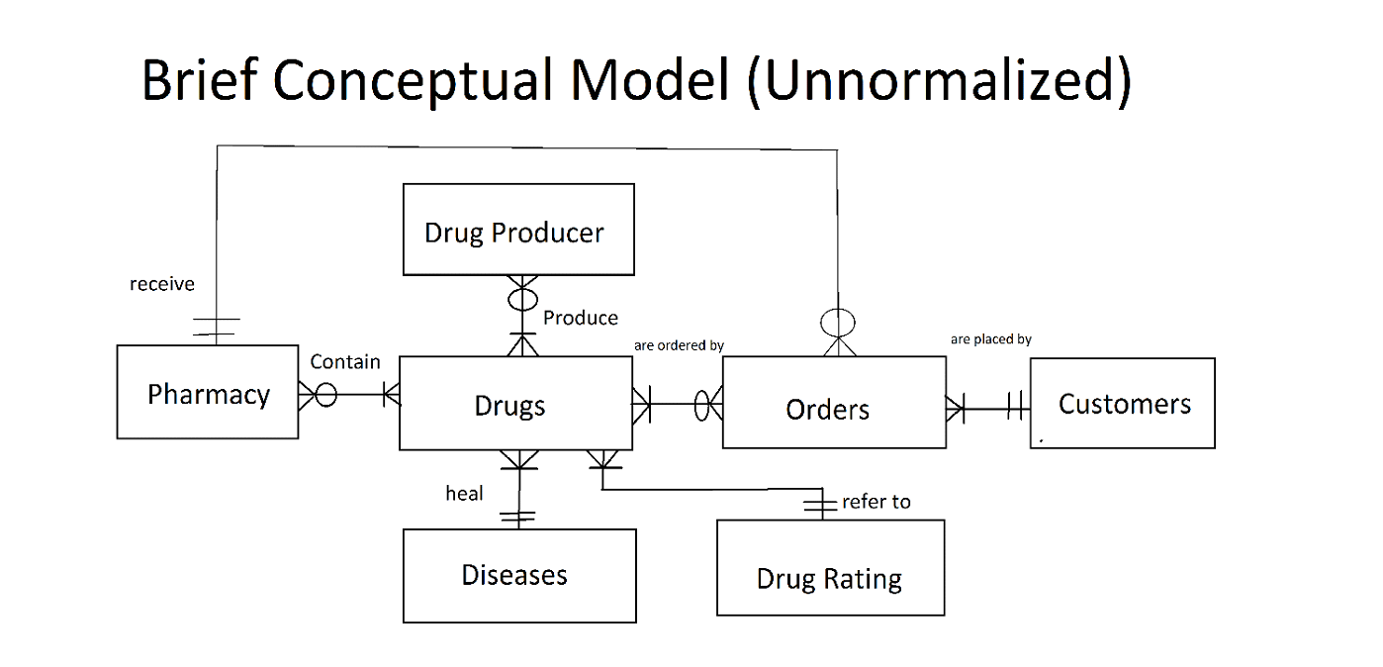
Conceptual model (ERD)

Slide 8
Conceptual model (ERD)

Slide 9
Logical design - Tables
Tables
Drug Producer
Drugs
Product
Pharmacy
In - store Drugs
Diseases
Drug Rating
Orders
OrderItems
Customers

Slide 10
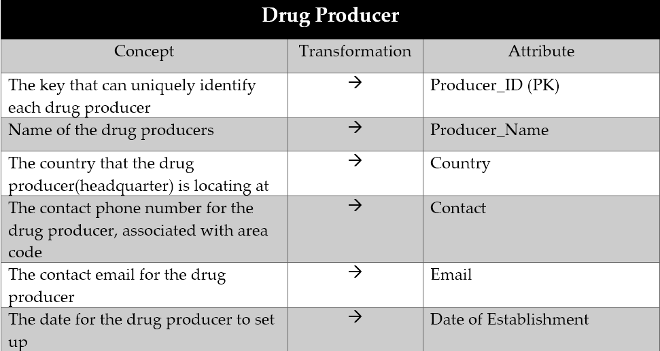
Logical design - Tables

Slide 11
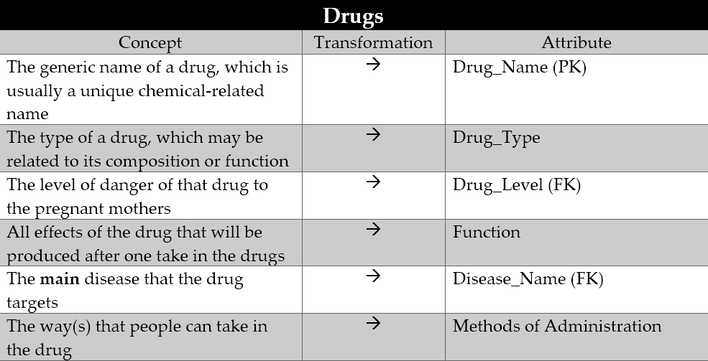
Logical design - Tables

Slide 12
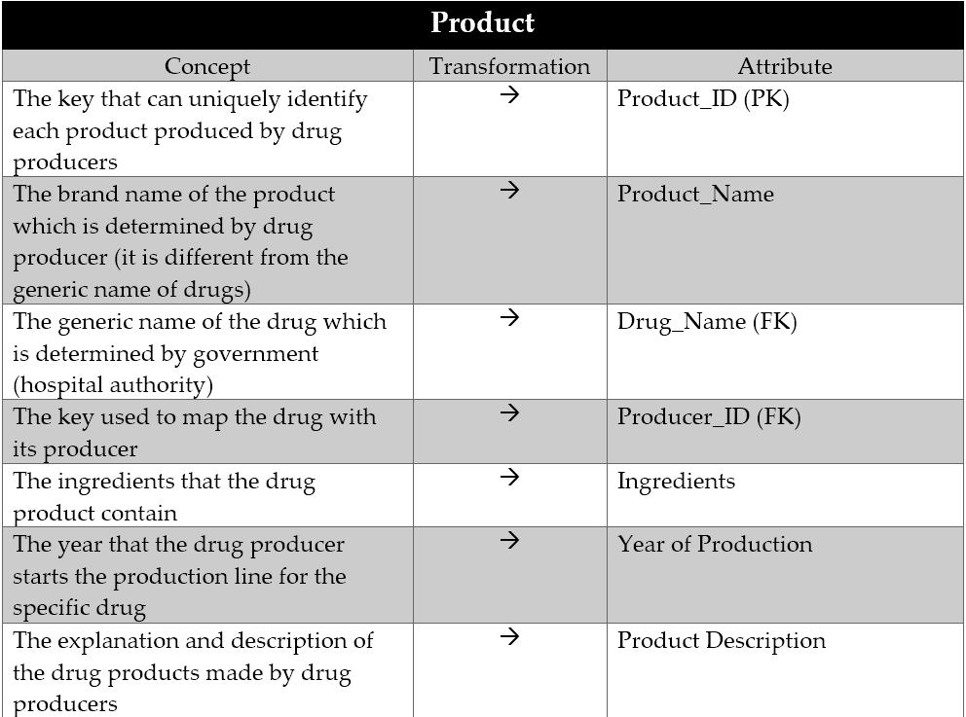
Logical design - Tables

Slide 13
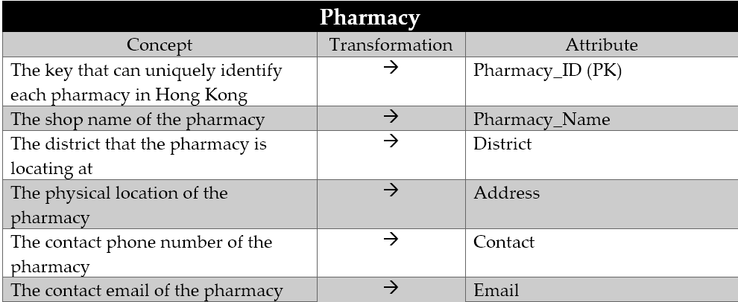
Logical design - Tables

Slide 14
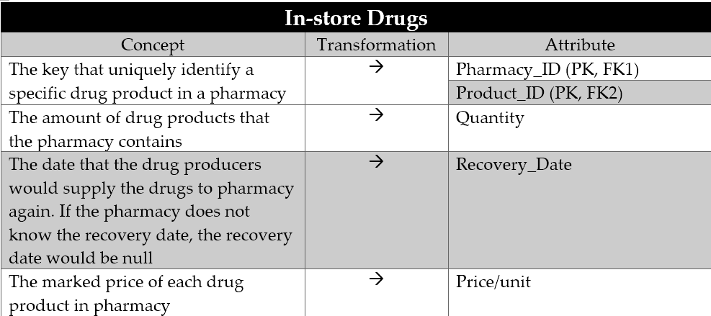
Logical design - Tables

Slide 15
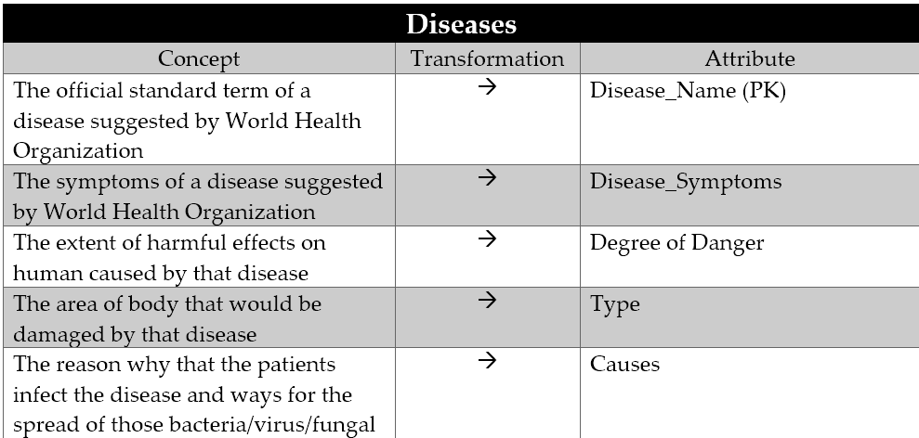
Logical design - Tables

Slide 16
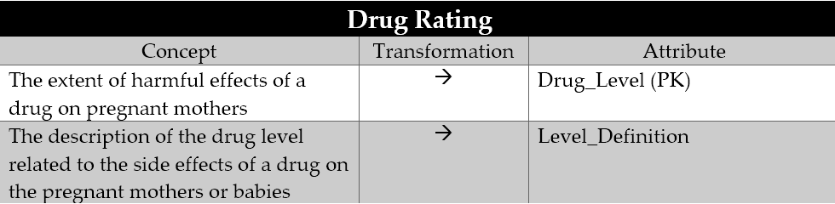
Logical design - Tables

Slide 17
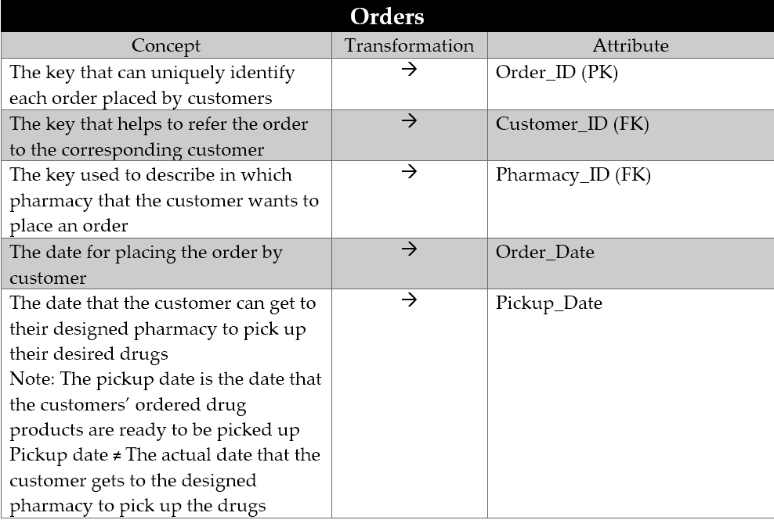
Logical design - Tables

Slide 18
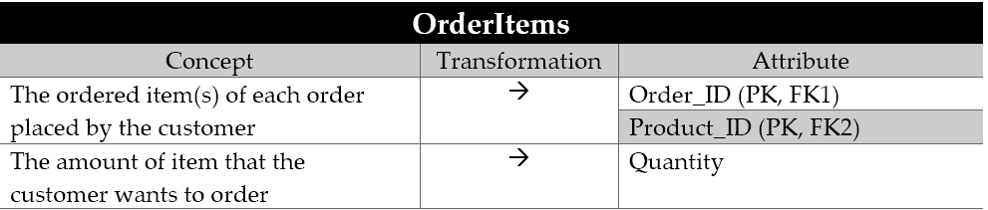
Logical design - Tables

Slide 19
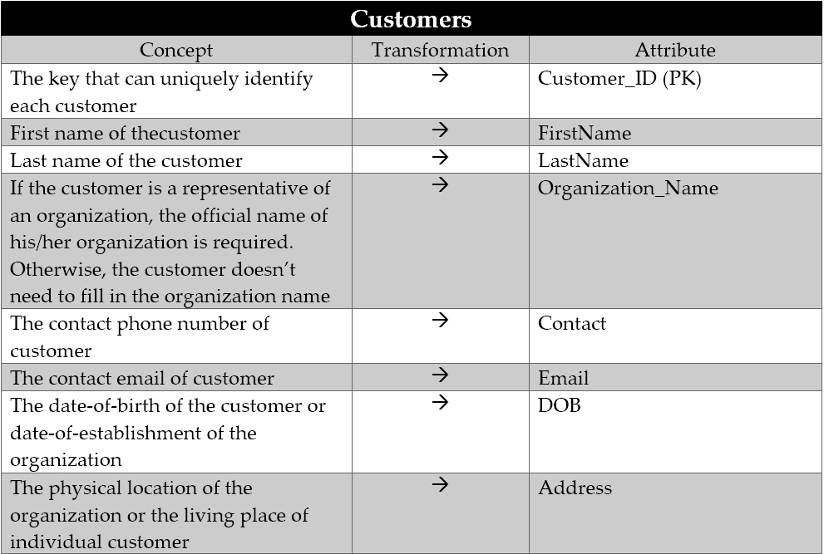
Logical design - Tables

Slide 20
Logical design - Queries Design
Queries Design
Customers
Pharmacy
Drug Producer
Government

Slide 21
Logical design - Queries Design
Customers
Detailed Information for Drug Products
Drug Products for Chronic
Drug Products for Infectious
Drug Products for Intestinal
Drug Products for Month
Drug Products for Nail
Drug Products for Skin
Pharmacies Ordered by District

Slide 22
Logical design - Queries Design
Pharmacy
Highest Demanded Drug(s)
Orders That Are Not Processed
Total Free for Each Order
Total Ordered Amount for Each Product
Drug Producer
Highest Demanded Drug(s)
Government
The Most Serious Disease in Hong Kong

Slide 23
Logical design - Forms Application
Forms
Customer Modification
Customer Entry Data
Customer Sub Form
Customers Check Order
Check Order Sub Form
Diseases Modification
Drug Producer Modification
Drug Producer Entry Data
Drug Producer Sub Form
Drugs (modification)
In - store Drugs
In - store Drugs Sub Form
Pharmacy Modification
Pharmacy Entry Data
Pharmacy Sub Form
Search Product

Slide 24
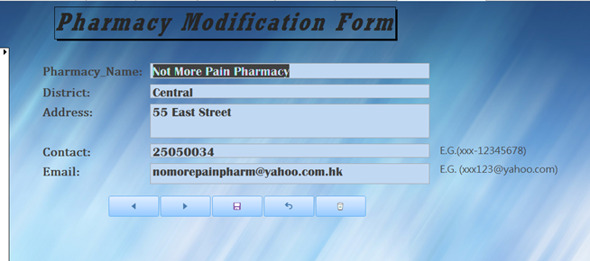
Logical design - Forms Application
example of Pharmacy Modification Form

Slide 25
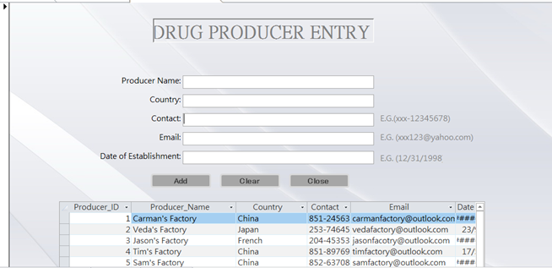
Logical design - Forms Application
example of Drug Producer Entry (with Sub Form)

Slide 26
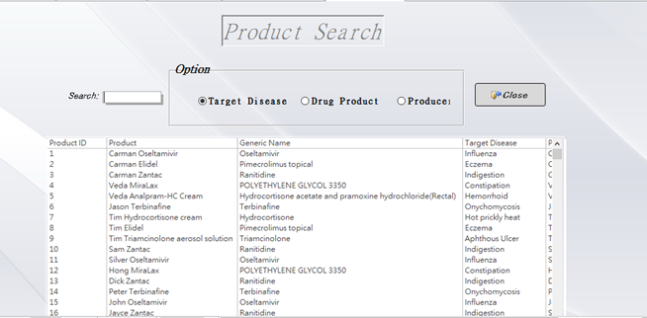
Logical design - Forms Application
example of Product Search Form (with Search function)

Slide 27
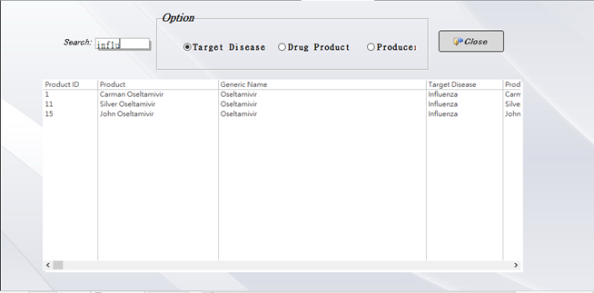
Logical design - Forms Application
example of Product Search Form (with Search function)

Slide 28
Logical design - Report Application
Reports
order that on or before 25/4/2015 report
Overview Report for Differnet Types of Diesease
Total Fee for Each Order_Report
Total Ordered Amount for Each Product
Overview Report for Differnet Types of Diesease
Drug Products for Chronic subreport
Drug Products for Infectious subreport
Drug Products for Intestinal subreport
Drug Products for Mouth subreport
Drug Products for Nail subreport
Drug Products for Skin subreport

Slide 29
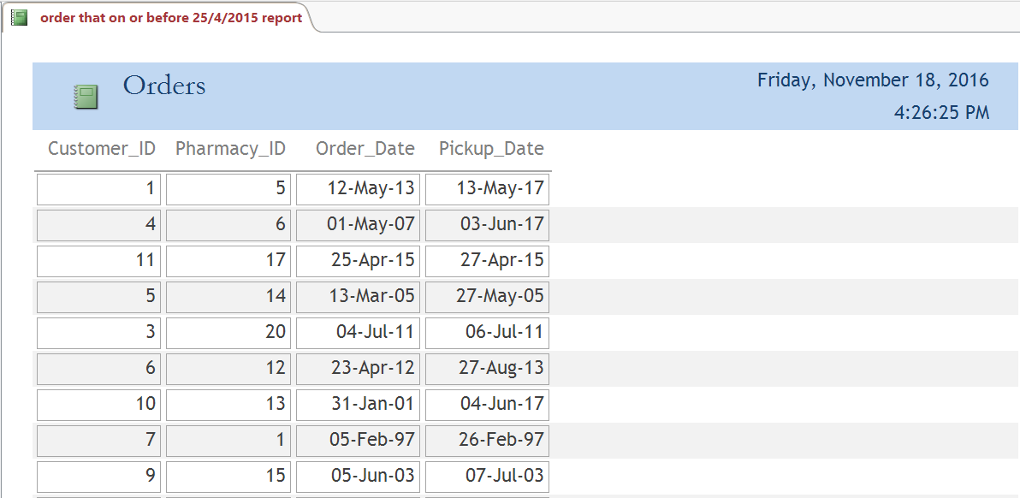
Logical design - Report Application
Example of Order Report

Slide 30
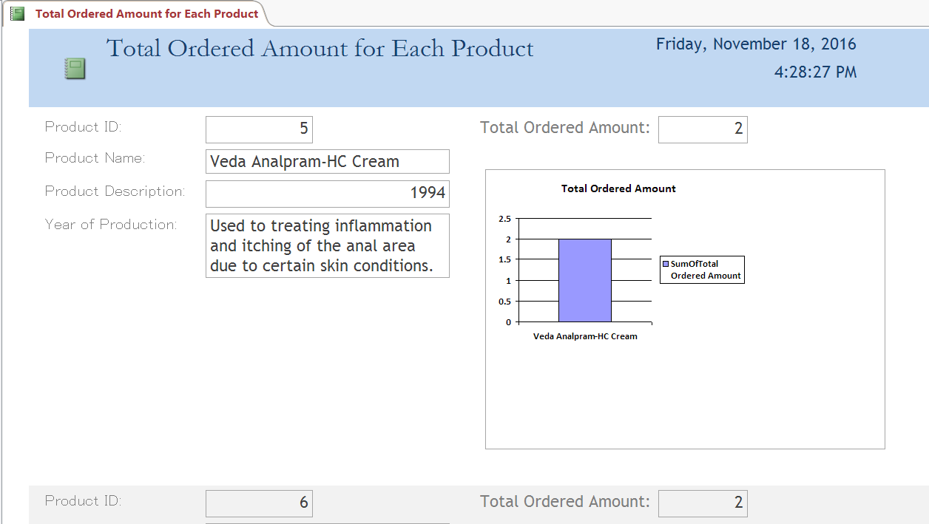
Logical design - Report Application
Example of Order Report

Slide 31
Logical design - Data Security Control
Data Security Control - Integrity Reinforcement
support build - in function for enhancing
data security
entity integrity
referential integrity
eventually
maximizes data consistency
minimizes data redundancy

Slide 32
Physical design - Software used
Microsoft Access 2016 will be selected for DBMS
Minimize the operating cost due to its inexpensive economic fee
$272 HKD / user for enterprise version E5
Compare with Oracle Database’s license fee - $47500 USD / user
causes a light burden on the computer’s storage devices
1 GB storage space requirement for installing Access
4 GB storage space requirement for installing Oracle Database

Slide 33
Physical design - Software used
support simple features and practical tools that can drastically arouse working efficiency
provides multiple templates that allow users to customize generation
easy - to - use features which required IT skills from the hospital authority’s staffs
High portability
easily be installed by following the guidelines of its internal install wizard
High mobility for data exchange
support data export and import between TXT, XML, ODBC Database
operate the data of Drug Information System in more flexible ways

Slide 34
Physical design - Source of data
Source of data is collected from
Pharmacies
Drug Producers
Customers
Hospital Authority
To construct an all-rounded and efficient database system

Slide 35
Physical design - Source of data
Pharmacies
Pharmacy Table
Provide their own pharmacy information
Pharmacy name
District
Address
Contact number
Email
In - Store Drugs table
Provide detailed information for their in-store drugs
Drug product name
Quantity
Recovery date
Orders Table
responsible to process the orders place by customers
Order date
Pick up date

Slide 36
Physical design - Source of data
Drug Producers
Drug Producer Table
Provide their organization information
Producer name
Country
Contact Number
Email Address
Date of Establishment
Product Table
Provide the information related to the drug products that they produced
Product Name
Drug Name ( Generic Name)
Ingredients
Year of Production
Product Description

Slide 37
Physical design - Source of data
Customers
Customers Table
provide their personal information to the pharmacies
First Name
Last Name
Organization Name
Contact Number
Email Address
Date of Birth
Address
Order Items Table
provide the information about the products that they want to order in a specified pharmacy
Drug Product
Quantity

Slide 38
Physical design - Source of data
Hospital Authority
Diseases Table
Provide the disease's name
Diseases name
Symptoms
Degree of Danger
Type
Causes
Drug Rating Table
remind the pregnant mothers
Drug Level
The corresponding Level Definition
Drugs Table
provide the chemical drug information
Drug Name (Official Generic Name)
Type
Level
Function
Corresponding Disease
Method of Administration

Slide 39
Implementation detail
(a) Flow charts of the program
(b) Sample results with explanation

Slide 40
Implementation detail -
Flow charts of the program
Program Procedures | Description
1 | Customers would register the fill their personal information through a program
2 | Personal information of customers will be validated, sent and stored in the database system
3 | The customers view and select their desired drugs and pharmacy and place an order for the drug product
4 | The data are validated and sent to the pharmacy
5 | The pharmacy receives the orders the update the pickup date of the orders if there is enough supply for the orders
6 | The customers receive their desired drug products

Slide 41
Implementation detail -
Sample results with explanation
Customers
Detailed Information for Drug Products
Drug Products for Chronic
Drug Products for Infectious
Drug Products for Intestinal
Drug Products for Month
Drug Products for Nail
Drug Products for Skin
Pharmacies Ordered by District

Slide 42
Implementation detail -
Sample results with explanation
Pharmacy
Highest Demanded Drug(s)
Orders That Are Not Processed
Total Free for Each Order
Total Ordered Amount for Each Product
Drug Producer
Highest Demanded Drug(s)
Government
The Most Serious Disease in Hong Kong

Slide 43
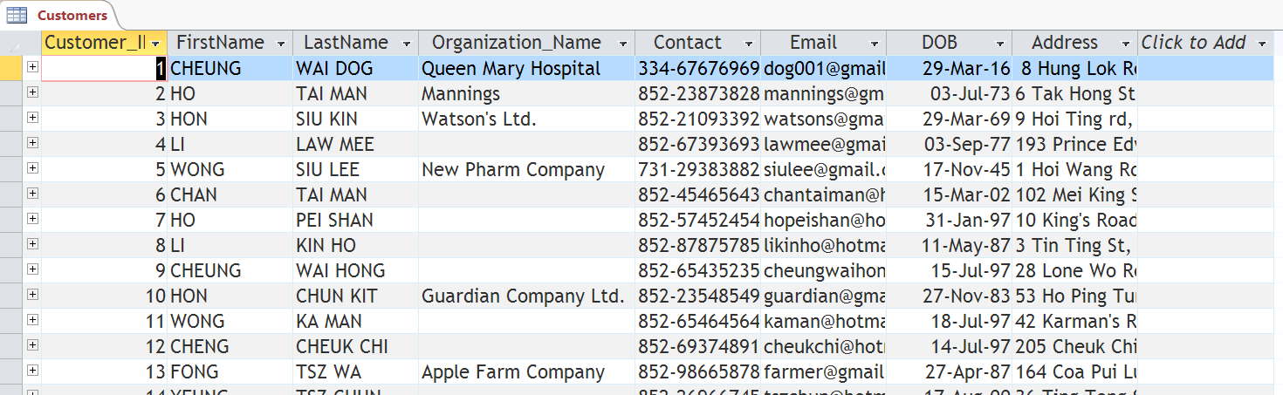
Implementation detail -
Sample results with explanation
example of Customer query

Slide 44
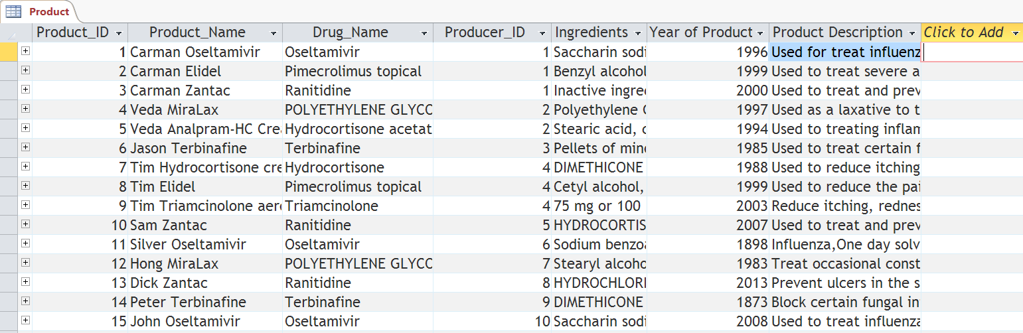
Implementation detail -
Sample results with explanation
example of Product query

Slide 45
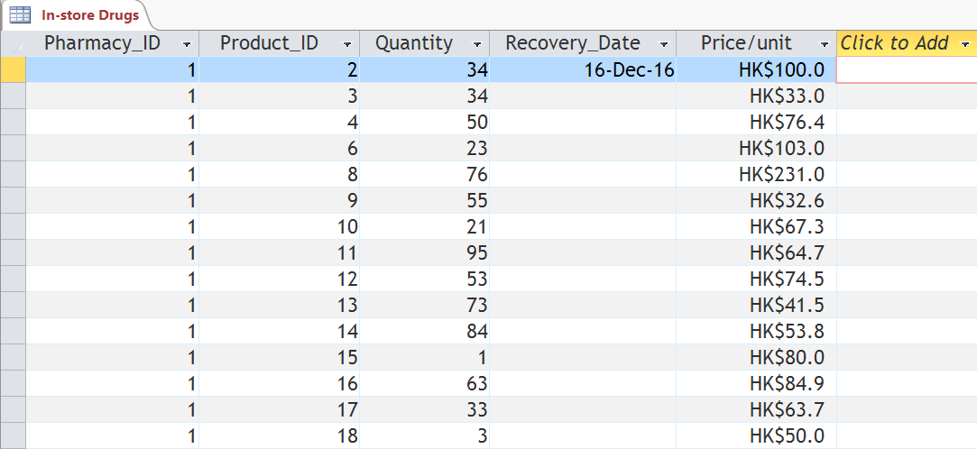
Implementation detail -
Sample results with explanation
Example of In - store Drugs query
example of Customer query

Slide 46
Difficulties
Design Phase
resolving M:N relationship between entities during design phase
Drugs are in M:N with 3 table at the same time
complicated
Implementation Phase
using VBA to create the forms and reports
no one in our team learnt about the function and syntax in VBA
misunderstand to construct an effective and workable graphical interface for data manipulation

Slide 47
Difficulties
Lesson Learnt
resolving M:N relationship and using VBA to create forms and reports
We had done a lot on researching information on internet
solved the problems by following the tutorial on internet in step - by - step approach
Facing a lot of obstacles and challenges
still try our best to finish the tasks since we believe
Attitude determines altitude

Slide 48
Conclusion
We gained a lot
experience
knowledge
passion
We also lost a lot
most of our time since we consume a lot of time on this project
Hope that drug information system can really be implemented to help citizens to search for their desired drugs easily
help a lot of patients to stay from diseases

